Slide 1
Challenges Facing Modern Society and Suggested Solutions
Navigating the Complexities of Contemporary Issues

Slide 2
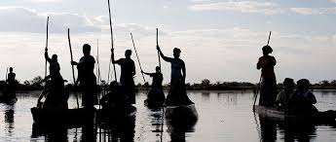

Slide 3
Understanding Modern Societal Challenges
Definition of modern societal challenges:
Modern societal challenges encompass a wide range of complex issues that affect individuals, communities, and societies worldwide.
These challenges manifest in various forms, including economic, environmental, technological, and social dimensions.
Importance of addressing these challenges:
Recognizing the critical need to confront and overcome these challenges to ensure a sustainable and prosperous future for all.
Understanding the interconnected nature of these challenges and their profound impact on human well-being and global stability.

Slide 4
Identification of Contemporary Societal Challenges
Economic inequality and poverty: Addressing disparities in income distribution and access to basic resources and opportunities.
Environmental degradation: Combatting climate change, pollution, deforestation, and loss of biodiversity to ensure environmental sustainability.
Technological disruption: Managing the impact of automation, artificial intelligence, and digital transformation on employment, privacy, and social cohesion.
Social justice and human rights: Upholding principles of equality, justice, and dignity for all individuals regardless of race, gender, ethnicity, or socio-economic status.
Health crises: Responding to global pandemics, infectious diseases, and healthcare disparities to safeguard public health and well-being.

Slide 5
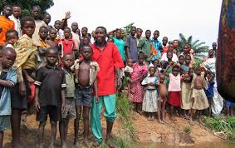

Slide 6
Impact of Contemporary Societal Challenges
Examination of the multifaceted impact of contemporary societal challenges:
Economic consequences: Analysis of how economic inequality and poverty hinder overall development, exacerbate social disparities, and contribute to social unrest.
Environmental implications: Discussion on the ecological ramifications of environmental degradation, including habitat destruction, resource depletion, and climate-related disasters.
Technological disruptions: Exploration of how technological advancements both enhance and disrupt traditional industries, reshape job markets, and influence social interactions.
Social and human rights repercussions: Consideration of the implications of systemic injustice, discrimination, and violations of human rights on marginalized communities and societal cohesion.
Public health ramifications: Evaluation of the health and well-being consequences of health crises, including mortality rates, healthcare infrastructure strain, and mental health challenges.
Recognition of the interconnected nature of these challenges and their collective impact on individuals, communities, and the broader society.

Slide 7


Slide 8
Proposed Solutions and Mitigation Strategies
Introduction of comprehensive strategies and interventions to address contemporary societal challenges effectively:Economic empowerment initiatives: Discussion on policies and programs aimed at reducing income inequality, promoting financial literacy, and creating opportunities for economic mobility.
Environmental conservation efforts: Examination of measures to mitigate environmental degradation, including sustainable resource management, renewable energy adoption, and conservation policies.
Technological innovation and adaptation: Exploration of strategies to harness technology for positive societal impact, such as digital literacy programs, workforce reskilling, and ethical tech development.
Social justice and human rights advocacy: Consideration of approaches to address systemic inequalities, promote diversity and inclusion, and protect human rights through policy reform and community engagement.
Public health interventions: Evaluation of strategies to enhance healthcare accessibility, improve disease prevention and management, and prioritize mental health support.

Slide 9

THANK YOU !

